Slide 1
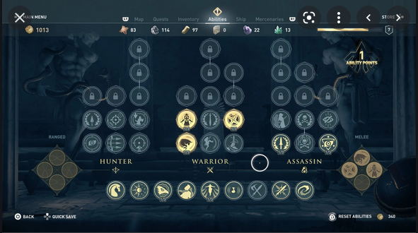
Pillars
There are customizable space ships (Instead of horses!) in the game.
There is a special skill tree, where the player can choose which path to take.
There is hundreds of quests for the player to take, and NPC's to meet.
The combat is fast paced, with laser weapons!

Slide 2

Games description
You play as an assassin. You have various tools and weapons to your disposal to defeat your enemies.
You can fly around in your spaceship and look for treasure and do extra challenged.
You can change your skills and talents based on your play style.
The combat is fast paced, and the player can dodge/parry/block/attack.

